Slide 1
DETECTION OF DEEPFAKE
SUPERVISED BY:
Dr. ANUPAM DAS
ASSOCIATE PROFESSOR
DEPARTMENT OF
COMPUTER SCIENCE & ENGINEERING
PREPARED BY :
Anwayajyoti Dey (192025004)
Samrat Dey (192025023)

Slide 2
OUTLINE
INTRODUCTION
LITERATURE REVIEW
MOTIVATION
OBJECTIVE
PROBLEM STATEMENT
PARTS OF THE PROJECT
THE PIPELINE OF OUR PROPOSED DEEPFAKE DETECTION METHOD
DATASETS

Slide 3
INTRODUCTION
"Deepfakes leverage powerful techniques from machine learning and artificial intelligence to manipulate or generate visual and audio content with a high potential to deceive.
FakeApp is the first method that has been used widely for deepfake creation.
VGGFace is another popular deepfake technique based on the Generative Adversarial Network (GAN).
CycleGAN is a deepfake technique that extracts the characteristics of one image and produces another image with the same characteristics via the GAN architectu`re.

Slide 4
LITERATURE REVIEW
.
SL No. | Author Name | Year Of Publication | Remarks
1 | Shruti Agarwal, Hany Farid, Yuming Gu, Mingming He, Koki Nagano, and Hao Li. | 2021 | Protecting world leaders against deep fakes. In Computer Vision and Pattern Recognition Workshops, volume 1, pages 38–45, 2021.
2 | Jiacheng Lin, Yang Li, and Guanci Yang. | 2019 | Face de-identification method with generative adversarial networks for social robots. Neural Networks.
3 | Darius Afchar | 2018 | It aims to demonstrate a solution to a small part of the misinformation problem. In particular, I detail here my approach in implementing a CNN-based DeepFake detector.
4 | Djork-Arné Clevert, Thomas Unterthiner, & Sepp Hochreiter. | 2015 | Fast and Accurate Deep Network Learning by Exponential Linear Units (ELUs).

Slide 5
MOTIVATION
DeepFakes involves videos, often obscene, in which a face can be swapped with someone else’s using neural networks. DeepFakes are a general public concern, thus it's important to develop methods to detect them.
Recent studies show that deepfake video and images have become heavily circulated through social channels. Detection of deepfake videos and images, therefore, has become increasingly critical and important.
Although deep learning has shown a remarkable performance in deepfakes detection, the quality of deepfake has been increasing. Hence, the current deep learning methods need to improve as well to successfully identify fake videos and images.

Slide 6
OBJECTIVE
This work primarily focuses on providing a comprehensive study for deepfake detection using deep-learning methods such as Recurrent Neural Network (RNN), Convolutional Neural Network (CNN).

Slide 7
PROBLEM STATEMENT
Deepfake detection is considered a binary classification problem, where given an image or video containing a face, the detector needs to identify whether the face is real or forged.

Slide 8
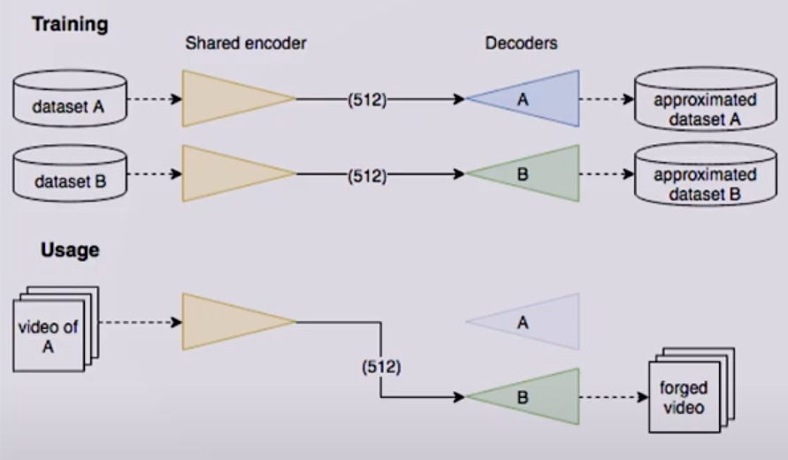
Generating DeepFakes

Slide 9
The Data :
└── data/
├── train/
│ ├── real/
│ │ ├── img1.png
│ │ └── img2.png
│ └── df/
│ ├── img1.png
│ └── img2.png
└── validation/
├── real/
│ ├── img1.png
│ └── img2.png
└── df/
├── img1.png
└── img2.png

Slide 10


Slide 11
.
MesoNet :
The Mesonet is one of the first models dedicated to the detection of the Deepfake video falsification technique.
NumPy :
NumPy stands for numeric python used for working with arrays.

Slide 12
.
TensorFlow :
TensorFlow is a popular framework of machine learning and deep learning. TensorFlow allows developers to create dataflow graphs—structures that describe how data moves through a graph, or a series of processing nodes.
Keras :
Keras is a high-level, deep learning API developed by Google for implementing neural networks.

Slide 13
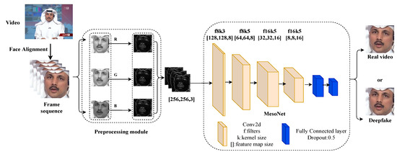
The pipeline of our proposed DeepFake detection method.
.

Slide 14
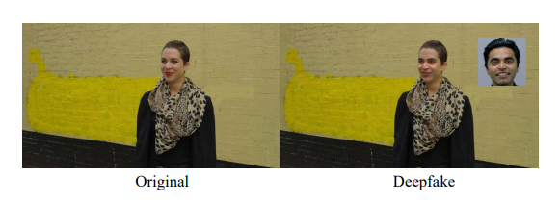
Example of Deepfake on social media, the image from DeepFakeDetection (DFD) dataset.
.

Slide 15
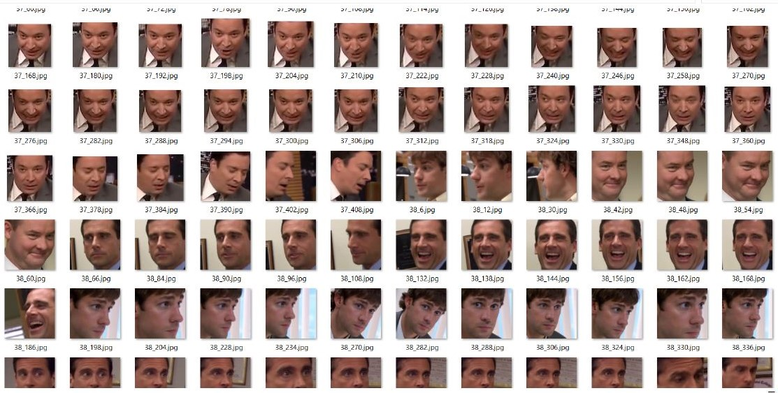
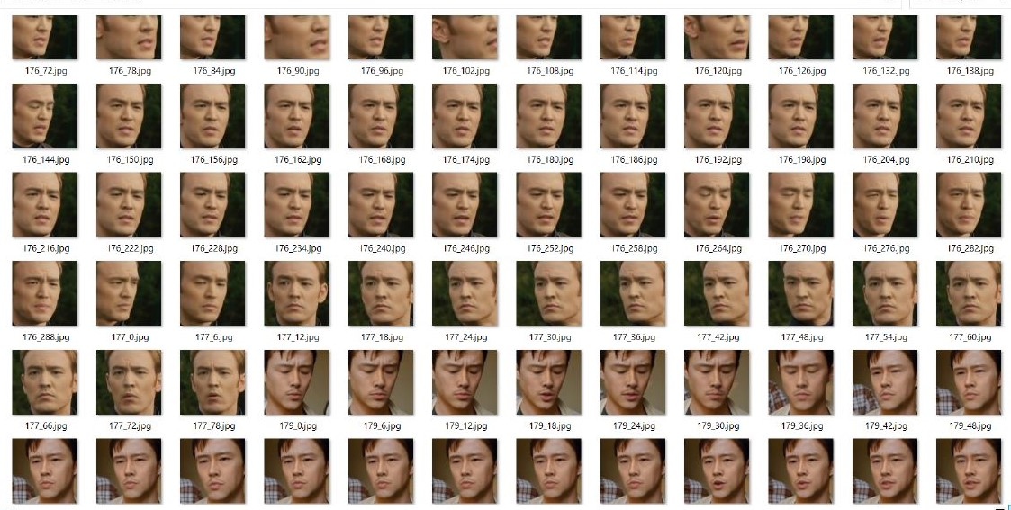
Dataset :
.
Real Dataset
DeepFake Dataset

